Slide 1
Association Rule

Slide 2

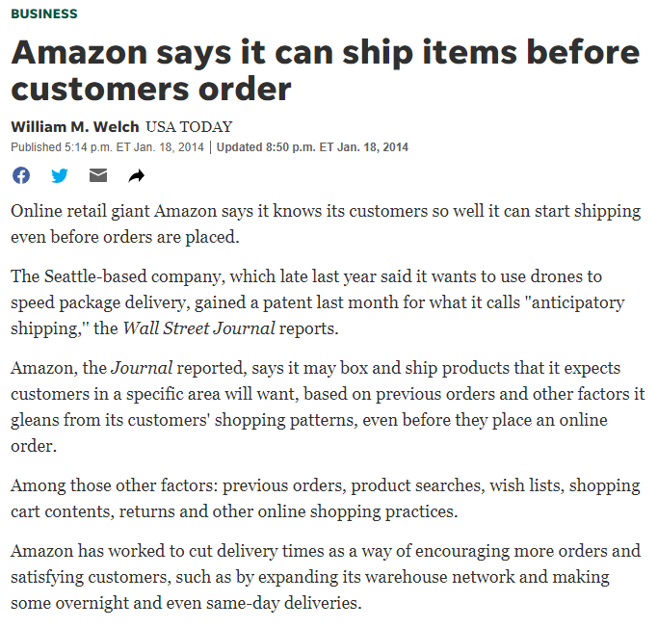

Slide 3
References
Introduction to Data Mining, 2nd Edition. Tan, Steinbach, Karpatne, Kumar. Chapter 5 and 6.
https://www-users.cse.umn.edu/~kumar001/dmbook/index.php

Slide 4
Association Rule
Association Rule Mining is an Unsupervised Learning algorithm to uncover how the items are associated with each other. The overarching motivation of Association Rule Mining is to seek which items appear together more frequently in transactions or relations.
It’s majorly used by retailers, grocery stores, an online marketplace that has a large transactional database.
The same way that any online social media, marketplace, and e-commerce websites know what you buy next using recommendations engines. The recommendations you get on item or variable, while you check out the order is because of Association rule mining boarded on past customer data.
These rules may further help the business analyst to come up with different strategies to maximize the sales.

Slide 5
Association Rule Mining
Given a set of transactions, find rules that will predict the occurrence of an item based on the occurrences of other items in the transaction
Market-Basket transactions
Example of Association Rules
{Diaper} → {Beer}, {Milk, Bread} → {Eggs,Coke}, {Beer, Bread} → {Milk},
Implication means co-occurrence, not causality!

Slide 6
Definition: Frequent Itemset
Itemset
A collection of one or more items
Example: {Milk, Bread, Diaper}
k-itemset
An itemset that contains k items
Support count (σ)
Frequency of occurrence of an itemset
E.g. σ({Milk, Bread,Diaper}) = 2
Support
Fraction of transactions that contain an itemset
E.g. s({Milk, Bread, Diaper}) = 2/5
Frequent Itemset
An itemset whose support is greater than or equal to a minsup threshold

Slide 7
Apriori
To understand Apriori, 3 concepts are crucial.
$$Support \left(I\right) =\frac{Number of Transactions containing I }{Total Number of Transactions }=\hat{Pr⁡} (I)$$
$$Confidence\left(I_{A} → I_{B}\right) =\frac{Number of Transactions containing I_{A} and I_{B} }{Number of Transactions containing I_{A} }=\frac{\hat{Pr⁡} (I_{A},I_{B})}{\hat{Pr⁡} (I_{A})}=\hat{Pr⁡} (I_{B}|I_{A})$$
$$Lift\left(I_{A} → I_{B}\right) =\frac{Confidence\left(I_{A} → I_{B}\right)}{Support (I_{B})}=\frac{\hat{Pr⁡}\left(I_{B} | I_{A}\right)}{\hat{Pr⁡} (I_{B})}=\frac{\hat{Pr⁡} (I_{A},I_{B})}{\hat{Pr⁡} (I_{A})\hat{Pr⁡} (I_{B})}=\hat{Pr⁡} (I_{A}|I_{B})$$

Slide 8
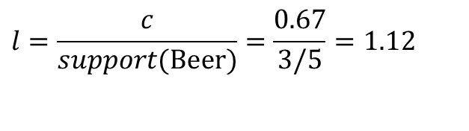
Definition: Association Rule
Association Rule
An implication expression of the form X → Y, where X and Y are itemsets
Example: {Milk, Diaper} → {Beer}
Rule Evaluation Metrics
Support (s)
Fraction of transactions that contain both X and Y
Confidence (c)
Measures how often items in Y appear in transactions that contain X
Lift(c)
Measures how probability of Y appear change if X is observed
Example:
$$l=\frac{c}{support(\text{Beer})}=\frac{0.67}{3/5}=1.12$$

Slide 9
Drawback of Confidence
Customers | Tea | Coffee | …
C1 | 0 | 1 | …
C2 | 1 | 0 | …
C3 | 1 | 1 | …
C4 | 1 | 0 | …
…
Association Rule: Tea → Coffee
Confidence ≅ P(Coffee|Tea) = 150/200 = 0.75
Confidence > 50%, meaning people who drink tea are more likely to drink coffee than not drink coffee
So rule seems reasonable

Slide 10
Drawback of Confidence
 | Coffee | Coffee
Tea | 150 | 50 | 200
Tea | 650 | 150 | 800
 | 800 | 200 | 1000
Association Rule: Tea → Coffee
Confidence= P(Coffee|Tea) = 150/200 = 0.75
but P(Coffee) = 0.8, which means knowing that a person drinks tea reduces the probability that the person drinks coffee!
Note that P(Coffee|Tea) = 650/800 = 0.8125

Slide 11
Drawback of Confidence
Customers | Tea | Honey | …
C1 | 0 | 1 | …
C2 | 1 | 0 | …
C3 | 1 | 1 | …
C4 | 1 | 0 | …
…
Association Rule: Tea → Honey Confidence ≅ P(Honey|Tea) = 100/200 = 0.50
Confidence = 50%, which may mean that drinking tea has little influence whether honey is used or not
So rule seems uninteresting
But P(Honey) = 120/1000 = .12 (hence tea drinkers are far more likely to have honey

Slide 12
There are lots of measures proposed in the literature

Slide 13

Apriori
Example:
Suppose we have records of 50,000 transactions. Among them, 3000 transactions include product A and 1500 transactions include product B. We observe that there are 800 transactions that include both product A and B.
𝑺𝒖𝒑𝒑𝒐𝒓𝒕 𝑰 =
𝑵𝒖𝒎𝒃𝒆𝒓 𝒐𝒇 𝑻𝒓𝒂𝒏𝒔𝒂𝒄𝒕𝒊𝒐𝒏𝒔 𝒄𝒐𝒏𝒕𝒂𝒊𝒏𝒊𝒏𝒈 𝑰
⇒ 𝑺𝒖𝒑𝒑𝒐𝒓𝒕 𝑰
=
𝟑𝟎𝟎𝟎
= 𝟎. 𝟎𝟔 , 𝑺𝒖𝒑𝒑𝒐𝒓𝒕 𝑰 =
𝟏𝟓𝟎𝟎
= 𝟎. 𝟎𝟑
𝑻𝒐𝒕𝒂𝒍 𝑵𝒖𝒎𝒃𝒆𝒓 𝒐𝒇 𝑻𝒓𝒂𝒏𝒔𝒂𝒄𝒕𝒊𝒐𝒏𝒔
𝑨
𝟓𝟎𝟎𝟎𝟎
𝑩
𝟓𝟎𝟎𝟎𝟎
𝑪𝒐𝒏𝒇𝒊𝒅𝒆𝒏𝒄𝒆 𝑰 𝒂𝒏𝒅 𝑰 =
𝑵𝒖𝒎𝒃𝒆𝒓 𝒐𝒇 𝑻𝒓𝒂𝒏𝒔𝒂𝒄𝒕𝒊𝒐𝒏𝒔 𝒄𝒐𝒏𝒕𝒂𝒊𝒏𝒊𝒏𝒈 𝑰_{𝑨} 𝒂𝒏𝒅 𝑰_{𝑩}
𝑵𝒖𝒎𝒃𝒆𝒓 𝒐𝒇 𝑻𝒓𝒂𝒏𝒔𝒂𝒄𝒕𝒊𝒐𝒏𝒔 𝒄𝒐𝒏𝒕𝒂𝒊𝒏𝒊𝒏𝒈 𝑰_{𝑨}
=
𝟖𝟎𝟎
= 𝟐𝟔. 𝟔𝟕%
𝑨
𝑩
𝟑𝟎𝟎𝟎
𝑪𝒐𝒏𝒇𝒊𝒅𝒆𝒏𝒄𝒆 𝑰_{𝑨} 𝒂𝒏𝒅 𝑰_{𝑩 =} 𝟐𝟔.𝟔𝟕% _{= 𝟖. 𝟖𝟗%}
𝑺𝒖𝒑𝒑𝒐𝒓𝒕 𝑰_{𝑩} 𝟑%
𝑳𝒊𝒇𝒕 𝑰_{𝑨} 𝒂𝒏𝒅 𝑰_{𝑩} =

Slide 14
Apriori
Example:
Suppose we have records of 50,000 transactions. Among them, 3000 transactions include product A and 1500 transactions include product B. We observe that there are 800 transactions that include both product A and B. We also see 700 transactions include product C and there are 400 transactions that include product A, B, and C.
𝑺𝒖𝒑𝒑𝒐𝒓𝒕 𝑰_{𝑨} , 𝑺𝒖𝒑𝒑𝒐𝒓𝒕 𝑰_{𝑩} , 𝑺𝒖𝒑𝒑𝒐𝒓𝒕 𝑰_{𝑪} ?
𝑪𝒐𝒏𝒇𝒊𝒅𝒆𝒏𝒄𝒆 𝑰_{𝑨}, 𝑰_{𝑩}, 𝑰_{𝑪} ?
𝑳𝒊𝒇𝒕 𝑰_{𝑨}, 𝑰_{𝑩}, 𝑰_{𝑪} ?

Slide 15
Apriori
Example:
Suppose we have records of 50,000 transactions. Among them, 3000 transactions include product A and 1500 transactions include product B. We observe that there are 800 transactions that include both product A and B. We also see 700 transactions include product C and there are 400 transactions that include product A, B, and C.
𝑺𝒖𝒑𝒑𝒐𝒓𝒕 𝑰_{𝑨} = 𝟎. 𝟎𝟔 , 𝑺𝒖𝒑𝒑𝒐𝒓𝒕 𝑰_{𝑩} = 𝟎. 𝟎𝟑, 𝑺𝒖𝒑𝒑𝒐𝒓𝒕 𝑰_{𝑪} = 𝟎. 𝟎𝟏𝟒
𝑪𝒐𝒏𝒇𝒊𝒅𝒆𝒏𝒄𝒆 𝑰_{𝑨}, 𝑰_{𝑩}, 𝑰_{𝑪} = 𝟎. 𝟓𝟎
𝑳𝒊𝒇𝒕 𝑰_{𝑨}, 𝑰_{𝑩}, 𝑰_{𝑪} = 𝟑𝟓. 𝟕𝟏%

Slide 16
Apriori
Algorithm
Set the threshold value for Support and Confidence
Consider all the subsets in transactions with higher Support than the threshold value
Consider all the (association) rules of these subsets with higher Confidence than the threshold Confidence
value
Sort the (association) rules by descending Lift

Slide 17
Frequent Itemset Generation
Given d items, there are 2^{d} possible candidate itemsets

Slide 18
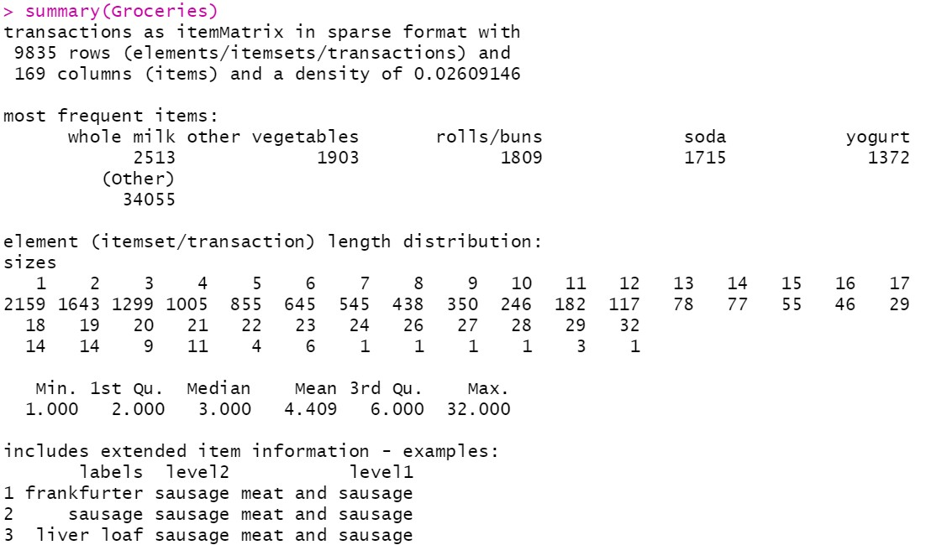


Apriori
Application

Slide 19
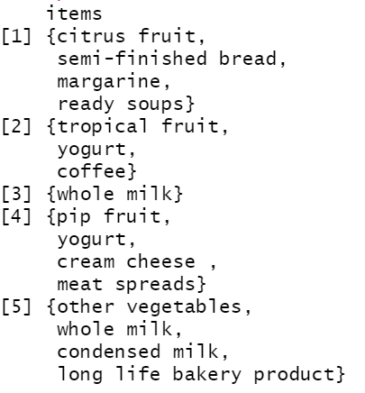

Apriori
Application

Slide 20
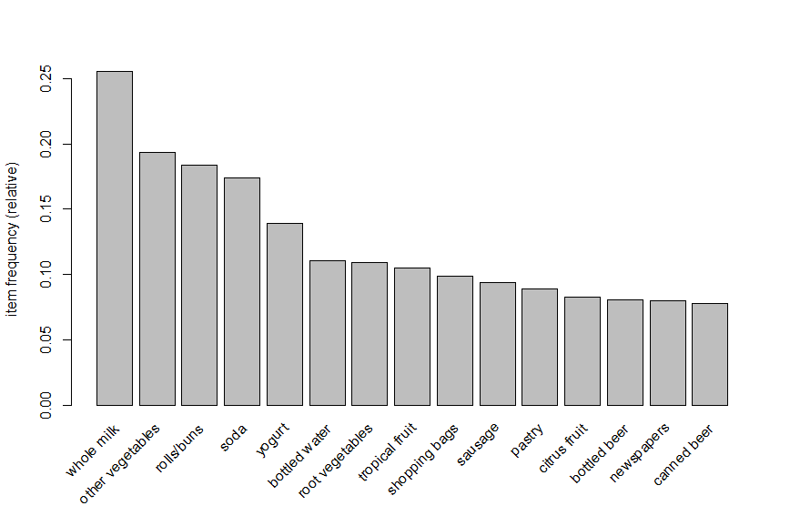
Apriori
Application

Slide 21
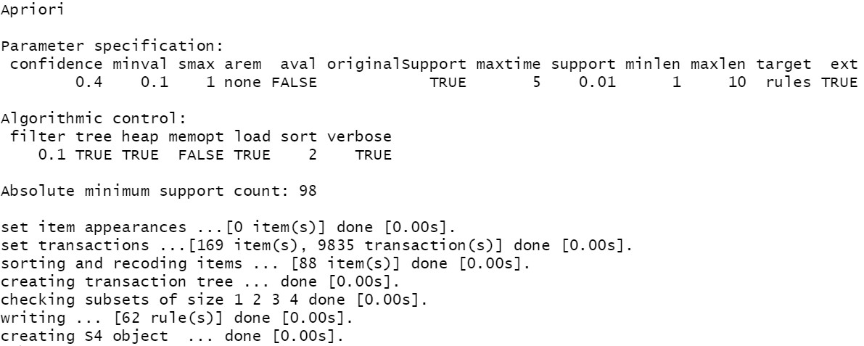
Apriori
Application

Slide 22
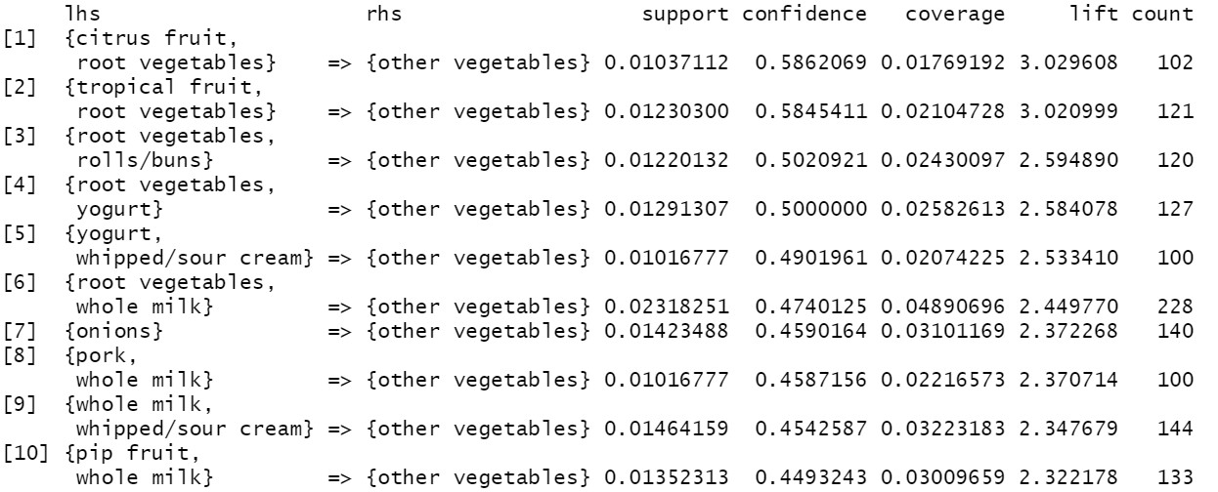
Apriori
Application

Slide 23
Apriori
Considerations
If we want to get stronger rules, we have to increase the confidence.
If we want lengthier rules, we have to increase the maxlen parameter.
If we want to eliminate shorter rules, we have to increase the minlen parameter.

Slide 24
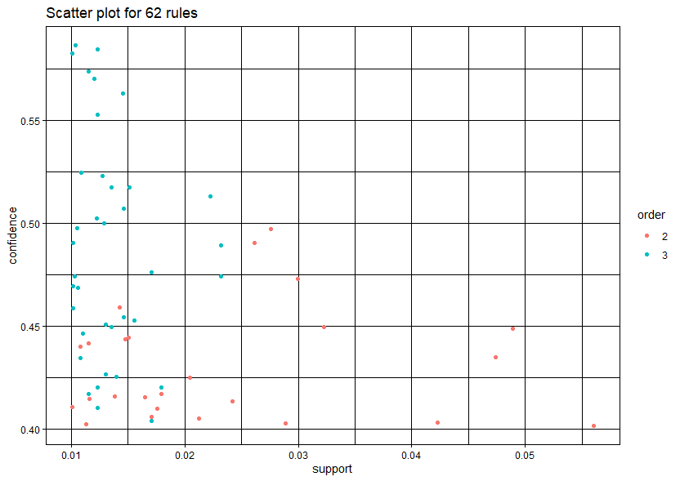
Apriori
Application

Slide 25
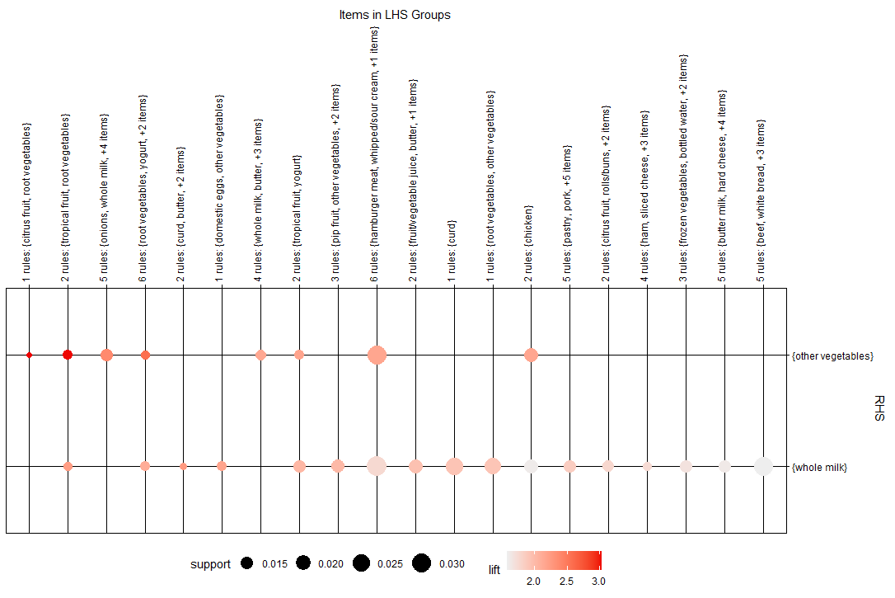
Apriori
Application

Slide 26
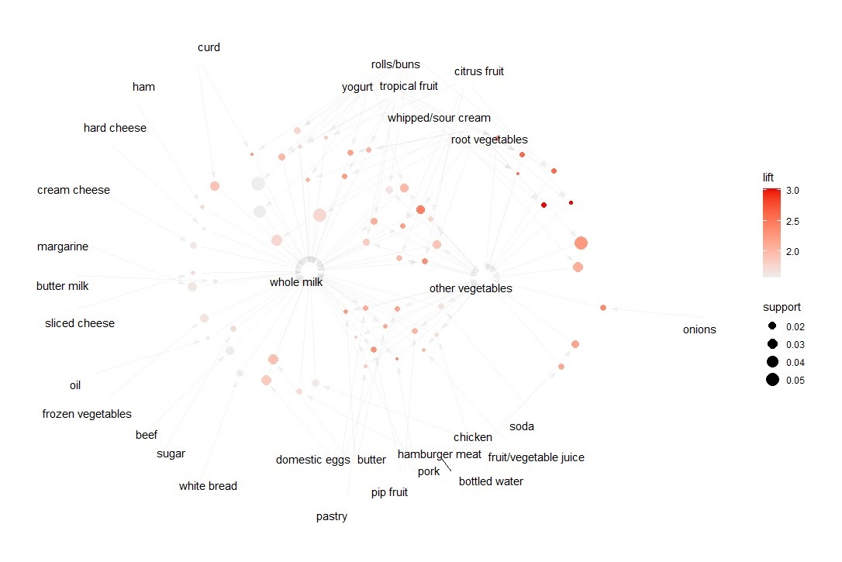
Apriori
Application

Slide 27
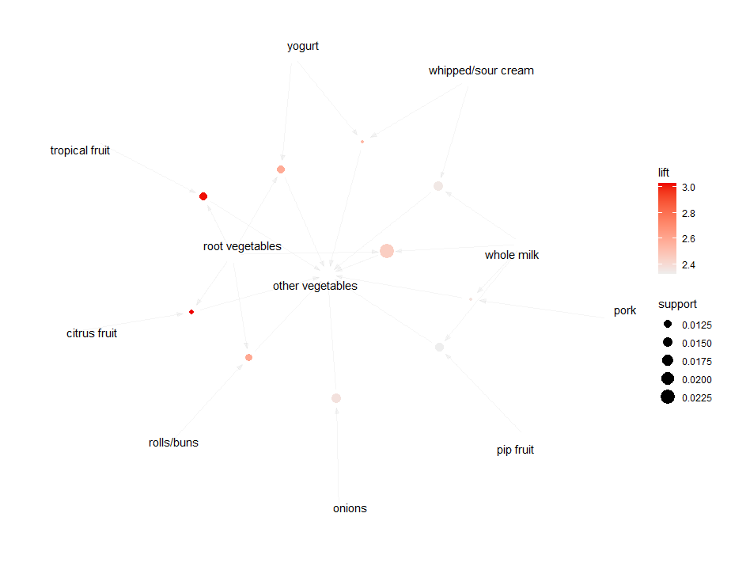

Apriori
Application

Slide 28
Recommendation Techniques: Going Beyond Apriori
Recommender Systems primarily have three things
Background Data
The information that the system has before the recommendation process begins
Input Data
The information that the user must communicate to the system in order to generate a recommendation
An Algorithm
That combines background and input data to arrive at its suggestion
On this basis, we can distinguish five different recommendation techniques

Slide 29
Recommendation Techniques
Technique | Background | Input |  | Process
Collaborative | Ratings from U of items in I. | Ratings from u of items in I. |  | Identify users in U similar to u, and extrapolate from their ratings of i
Content-based | Features of items in I | u’s ratings of items in I |  | Generate a classifier that fits u’s rating behavior and use it on i
Demographic | Demographic information about U and their ratings of items in I. | Demographic information about u. |  | Identify users that are demographically similar to u, and extrapolate from their ratings of i.
Utility-based | Features of items in I. | A utility function over items in I that describes u’s preferences. |  | Apply the function to the items and determine i’s rank.
Knowledge- based | Features of items in I. Knowledge of how these items meet a user’s needs. | A description of u’s needs or interests. |  | Infer a match between i and u’s need.
I is the set of items over which recommendations might be made i is some item for which we would like to predict u’s preference. |  |  | U is the set of users whose preferences are known u is the user for whom recommendations need to be generated

Slide 30
Tradeoffs between Recommendation Techniques
Technique | Pros | Cons
Collaborative Filtering | Can identify cross-genre niches Domain Knowledge not needed Adaptive: quality improves over time Implicit feedback sufficient | New user ramp-up problem New item ramp-up problem “Gray sheep” problem Quality dependent on large historical data set Stability vs. plasticity problem
Content-based | B, C, D | I, L, M
Demographic | A, B, C | I, K, L, M N. Must gather demographic information
Utility-based | No ramp-up required Sensitive to changes of preference Can include non-product features | O. User must input utility function P. Suggestion ability static
Knowledge-based | E,F, G H. Can map from user needs to products | P Q. Knowledge engineering required

Slide 31
Hybrid Recommendation Systems
Hybridization Method | Description
Weighted | The score or votes of several recommendation techniques are combined together to produce a single recommendation
Switching | The system switches between recommendation techniques depending on the current situation
Mixed | Recommendations from several different recommenders are presented at the same time
Feature Combination | Features from different recommendation data sources are thrown together into a single recommendation algorithm
Cascade | One recommender refines the recommendations given by another
Feature Augmentation | Output from one technique is used as an input feature to another
Meta-level | The model learned by one recommender is used as input to another

